Slide 1
IDEAL WASTE MANAGEMENT IN KOLAR SINCE 2014
Almitra H Patel
Member, Supreme Court Committee
for Solid Waste Management
in Class 1 Cities
almitrapatel@rediffmail.com
www.almitrapatel.com
1

Slide 2
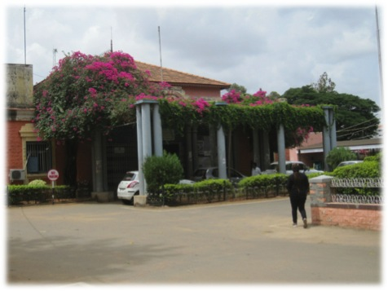
KOLAR CMC www.kolarcity.gov.in Pop 1.5 lac has NO SITE FOR WASTE MGT

Slide 3
In May 2014 they planned for ‘zero waste’ to landfill
They called in Clean Clities Foundation for help.
(See www.cleancitieschampionship.org)
All streets and lanes were mapped using city
maps and GIS and the entire area sub-divided
into Micro-Pockets of 350-400 households.
Maistrys became Route Managers and planned
doorstep routes and timings for their 2-person
teams who are left strictly undisturbed.

Slide 4
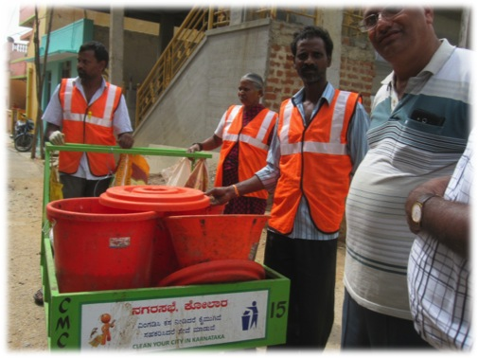
Door-to-door collection is in pushcarts with 4+4 covered 60-litre bins & 20 litre sorting basin

Slide 5
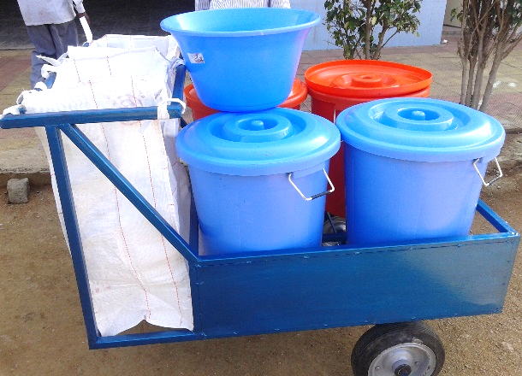
A sorting-basin first receives waste, for dry waste to go into bags and wet into bins

Slide 6
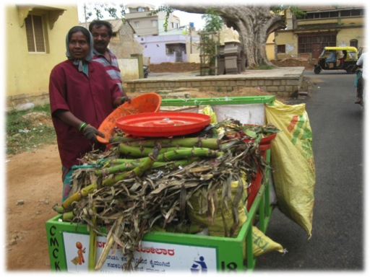
Two-person PK teams improvise, but keep wet and dry waste separate

Slide 7
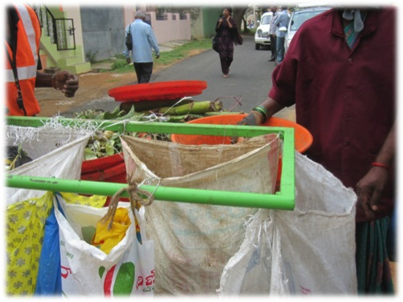
A double-handle helps to hang jumbo bags for paper and saleable plastic

Slide 8
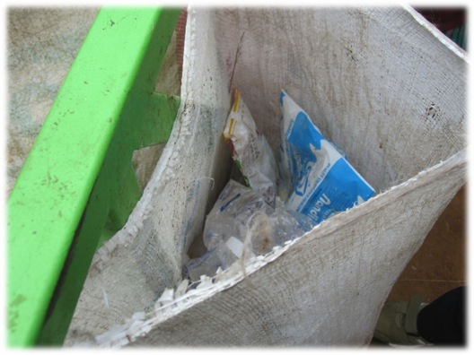
PKs can keep entire sale proceeds of all they collect, so doorstep sorting is good and absenteeism is low

Slide 9
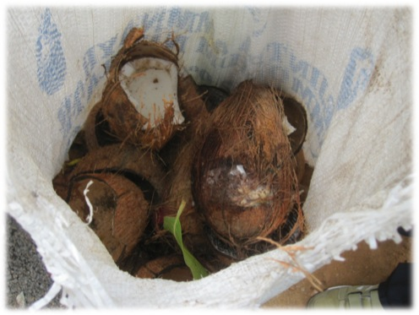
PKs take Copra-shells home for burning as fuel for hot water

Slide 10
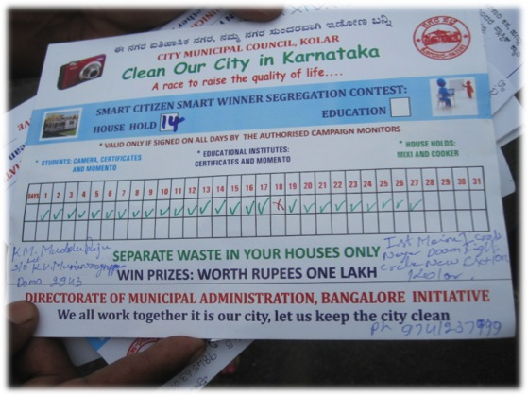
Homes giving wet-dry unmixed each day for a month can enter a prize lottery

Slide 11
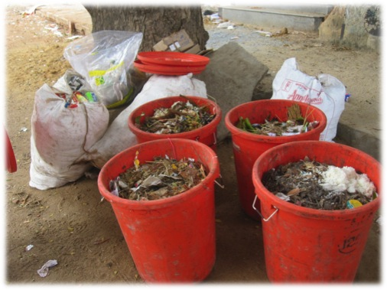
Each team covers 400 houses 6:30-10 am in 2 rounds. After 1st trip 4 bins and some bags are left briefly on road for pick-up

Slide 12
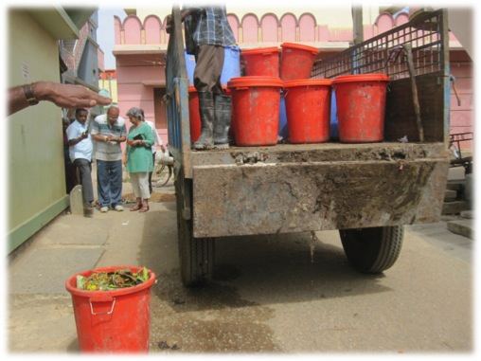
Tractors promptly pick up bins 10am-12 in 2 trips, + 3rd trip for dry waste if reqd

Slide 13
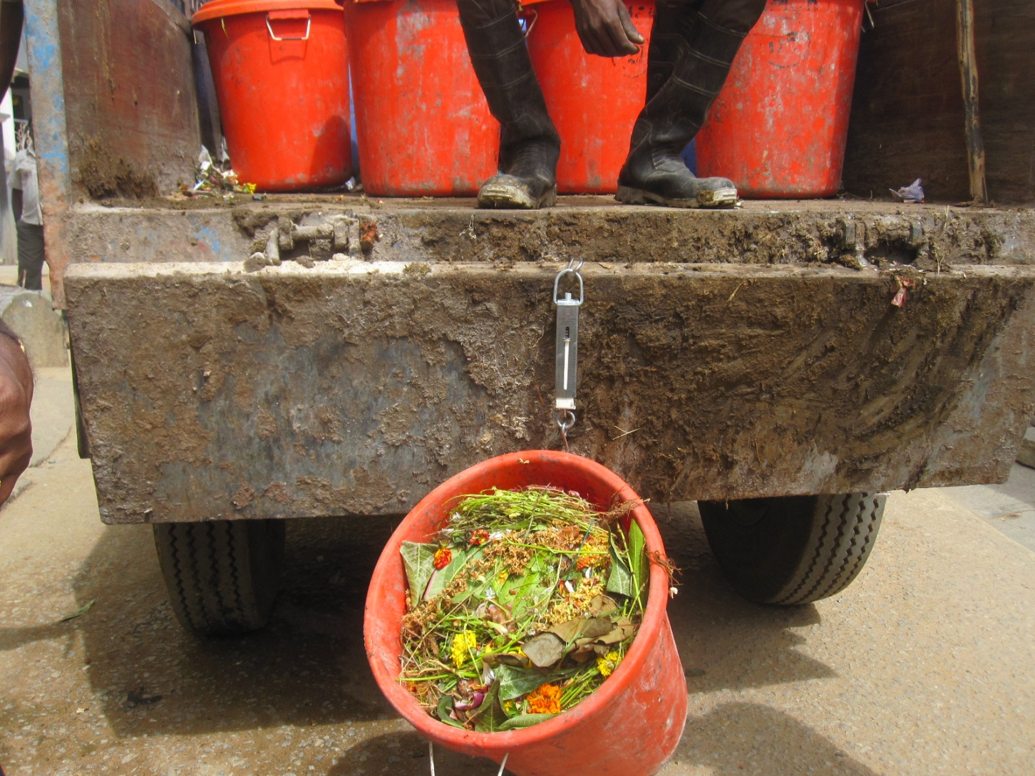
Every bin weighed on spring-scale before loading, to compile day’s pick-up data

Slide 14
Wet waste is managed by ‘Stack’ Composting within five inner-city locations
Tractors back up to stacks and its bins are emptied directly in thin layers per stack.
So no manual handling of waste is needed.

Slide 15
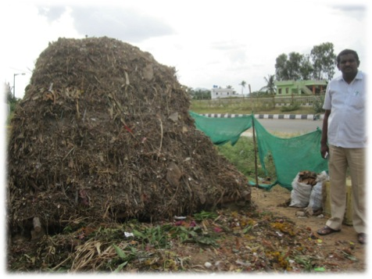
JULY ’14 KOLAR ADOPTED STACK COMPOSTING IN 5 SMALL SITES. This is 100 kg/day Wet waste x 1 month

Slide 16
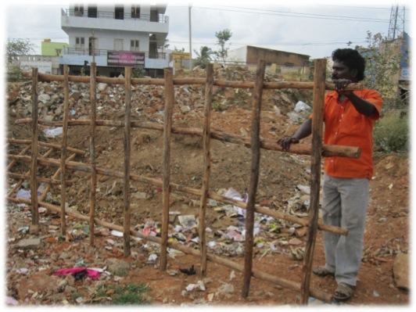
STACKS are formed on wood frames placed on stone supports

Slide 17
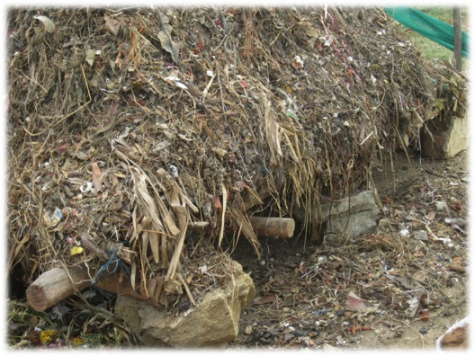
This keeps waste off the ground to allow cold air into heap as hot air rises

Slide 18
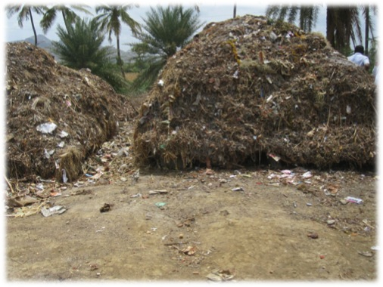
Stack composting is self-aerating. Needs no eqpt, power or labour, only 1-3 months’ time to stabilise waste.

Slide 19
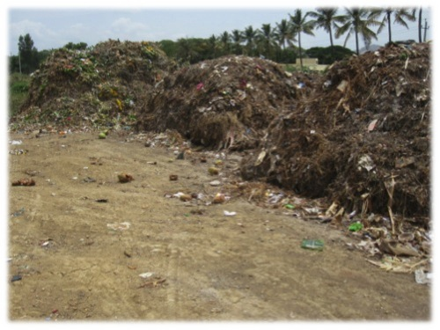
Waste is unloaded directly from tractors, in 8”layers , using more than 1 stack per day if needed

Slide 20
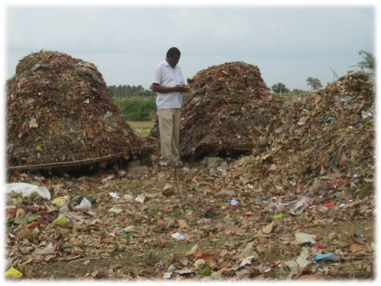
Stacks can be close together as no turning is needed

Slide 21
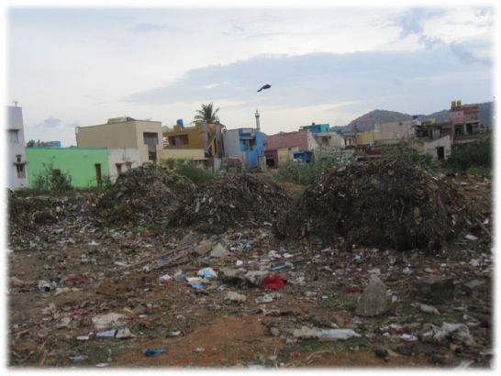
ONLY BIODEGRADABLE ‘WET’ WASTE is stacked, so unmixed collection is a must

Slide 22
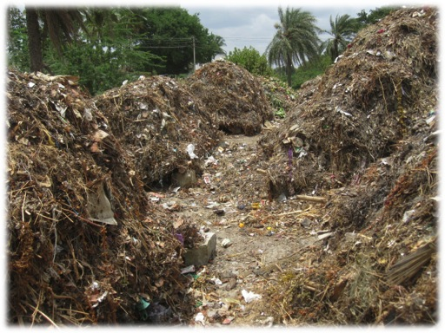
Stacks are ready for auction to farmers as early as 1 month of maturing

Slide 23
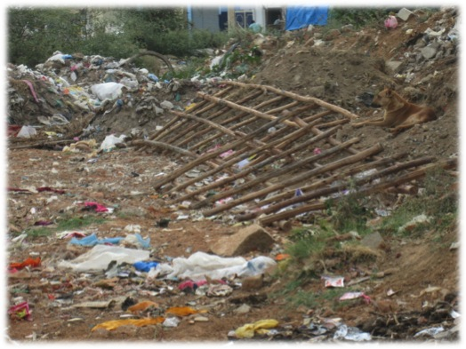
Wood frames are re-used after farmers remove compost

Slide 24
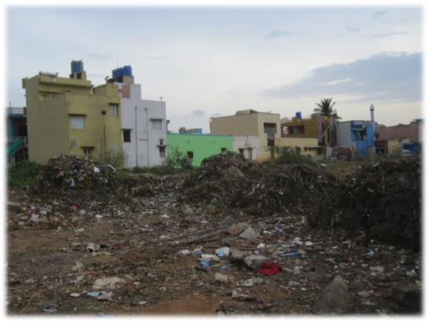
Even city-centre stacks are nuisance-free, but a visual barrier fence would help

Slide 25
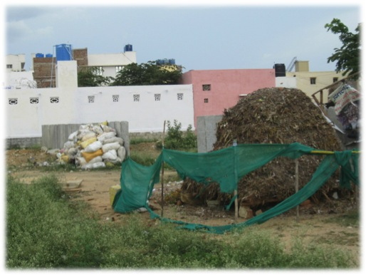
This is a demo of 100 kg/day in ward No 1, wet and dry waste separate

Slide 26
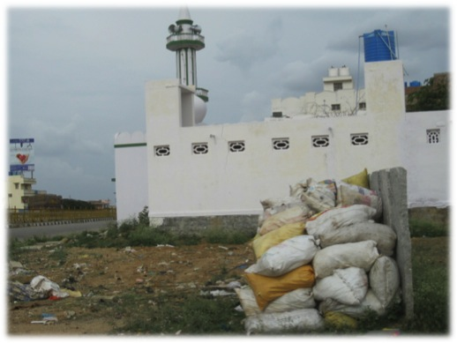
This demo is 100 kg/day Dry Waste from same Ward No 1, on NH75

Slide 27
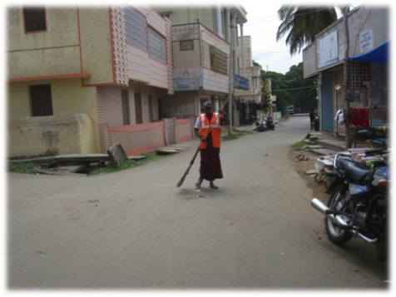
Same PK team does afternoon sweeping. Little waste ends on roads if their doorstep collection covers every house

Slide 28
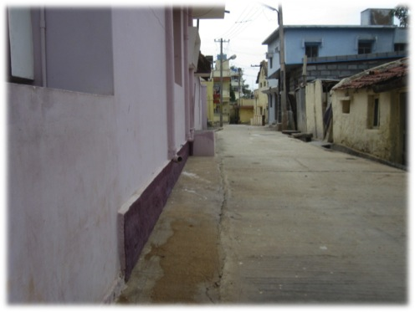
All slum lanes are spotless

Slide 29
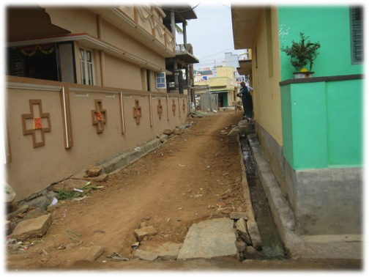
Even unpaved lanes and drains stay clean with doorstep collection

Slide 30
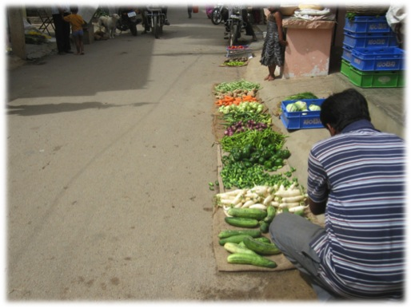
A complete ban on all-thickness plastic bags has helped immensely

Slide 31
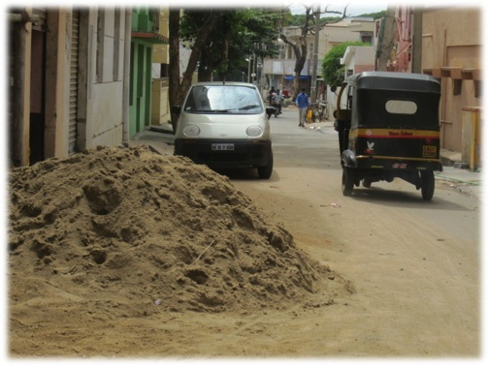
Now only management of construction waste obstructs the roads

Slide 32
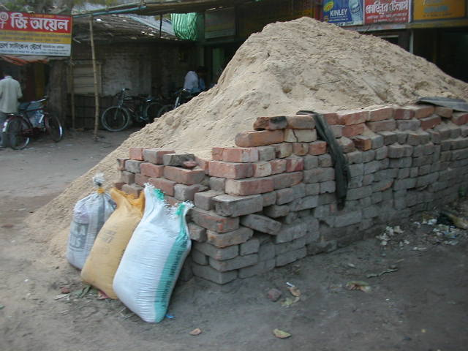
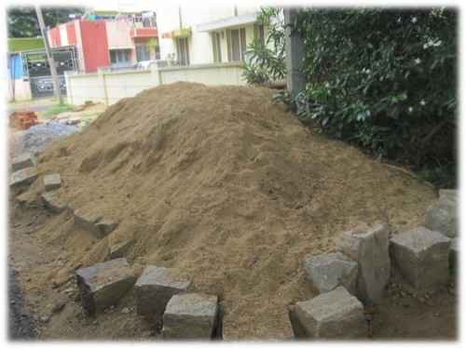
A ring of stones or sand-bags keeps sand off road and saves wastage

Slide 33
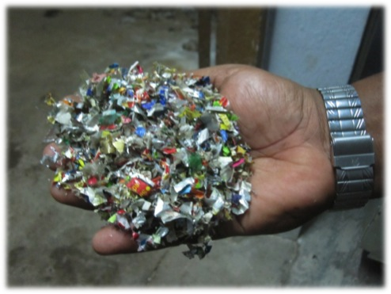
Unrecyclable plastics like ‘kurkure’ sachets and thermocole can be shredded and used for ‘plastic roads’

Slide 34
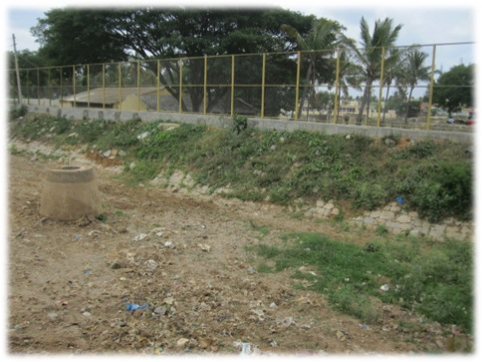
Storm-water drains have been cleared and fenced to keep out waste dumping

Slide 35
So a Zero-Waste City can be a reality !
What is needed is unity of DC, Commissioner and Councillors and continuity of policy from year to year despite transfers or elections.

